Slide 1
Minimizing Dockerfiles
Report 1 – 5th of April 2025
Andrei Petrea
scpetrea@gmail.com
Prof. Răzvan Deaconescu

Slide 2
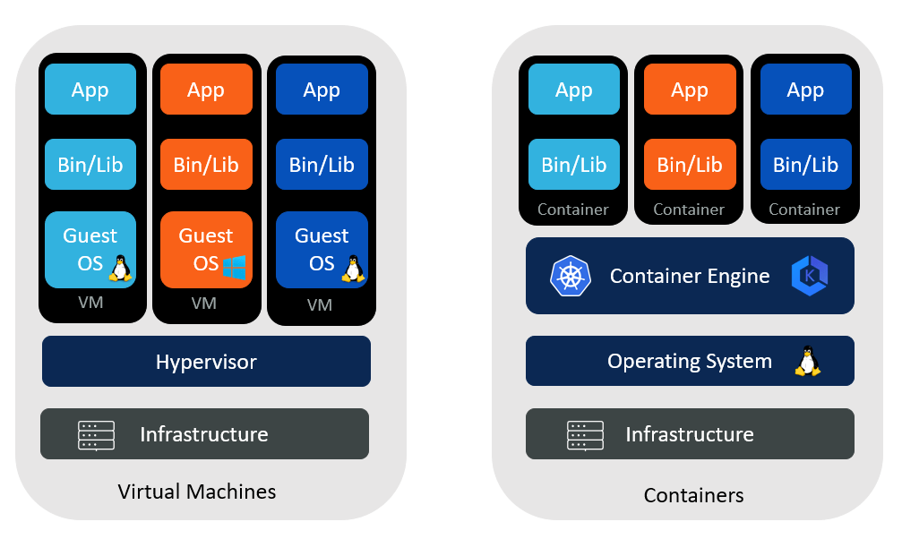
Introduction
VMs vs Containers ^{[1]}
2
Notes:
[1] Comparing VMs and Containers - Aqueduct Tech

Slide 3
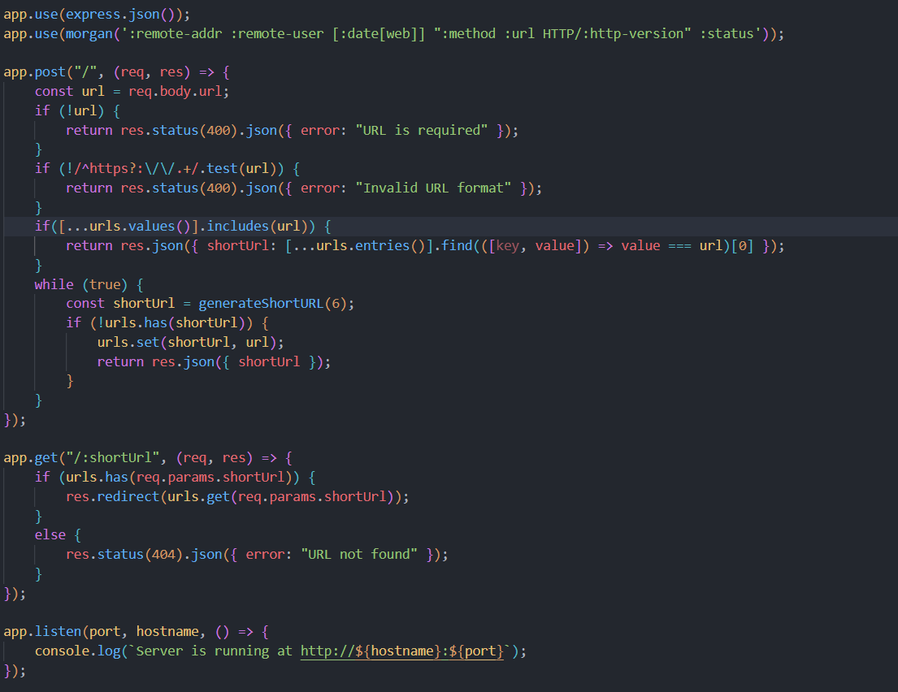
Motivation
Sample URL shortener app written in JavaScript using Express

Slide 4
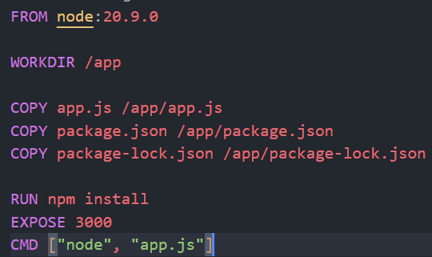
Motivation
1. Using the official node image^{[2]}
2. Building from the alpine linux image
3. Building from scratch
image size: 1.1GB
Notes:
[2] node - Official Image | Docker Hub

Slide 5
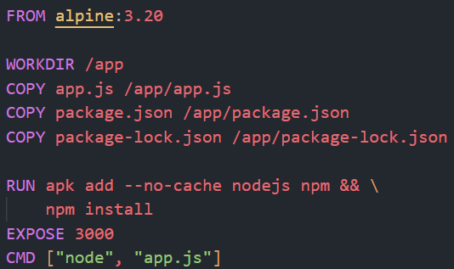
Motivation
1. Using the official node image
2. Building from the alpine linux image^{[3]}
3. Building from scratch
8MB linux distro
musl libc and busybox
- node:alpine, nginx: alpine python:alpine, mariadb:alpine etc.
image size: 75.1MB (93.33%↓)
Notes:
[3] alpine - Official Image | Docker Hub

Slide 6
Motivation
1. Using the official node image
2. Building from the alpine linux image
3. Building from scratch^{[4]}
Docker’s minimal image (no files)
each dependency has to be manually added
used mostly in multi-stage builds
Notes:
[4] scratch - Official Image | Docker Hub

Slide 7
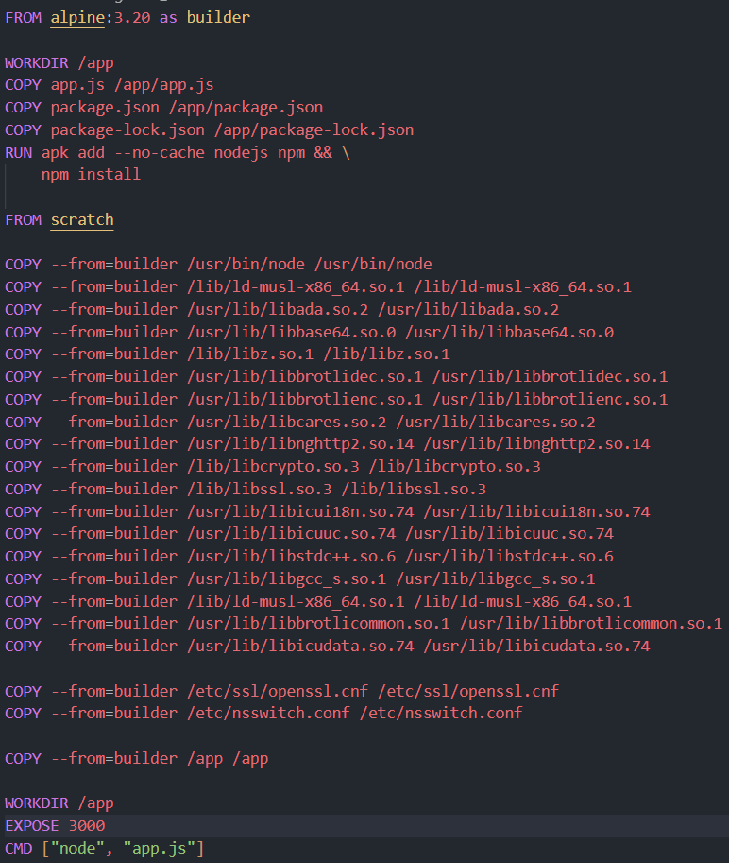
Motivation
builder image
image size: 61.7MB (17.84%↓, 94.5%↓)

Slide 8

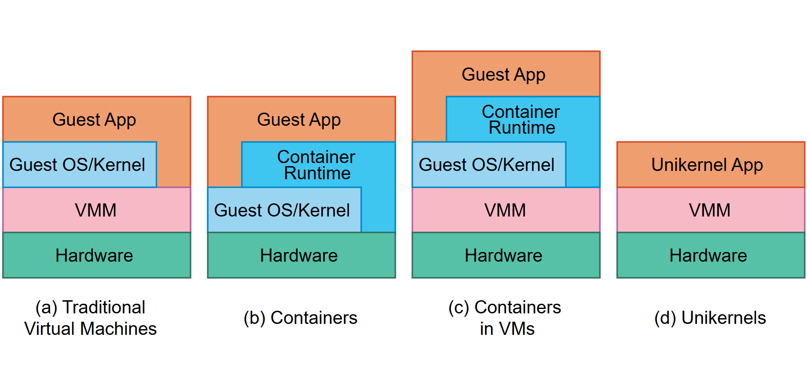
Use Case
High-level comparison of the software components of traditional VMs (a), containers (b), containers in VMs (c) with unikernels (d)^{[5]}
Notes:
[5] Concepts - Unikraft

Slide 9
Use Case
spec: v0.6
runtime: base:latest
rootfs: ./Dockerfile
cmd: ["/helloworld"]
minimal Dockerfile
Kraftfile for hello-world in C^{[6]}
Notes:
[6] catalog/examples/helloworld-c/Kraftfile at main · unikraft/catalog

Slide 10
How?
libraries identified by ldd
other files needed by the app found by strace

Slide 11
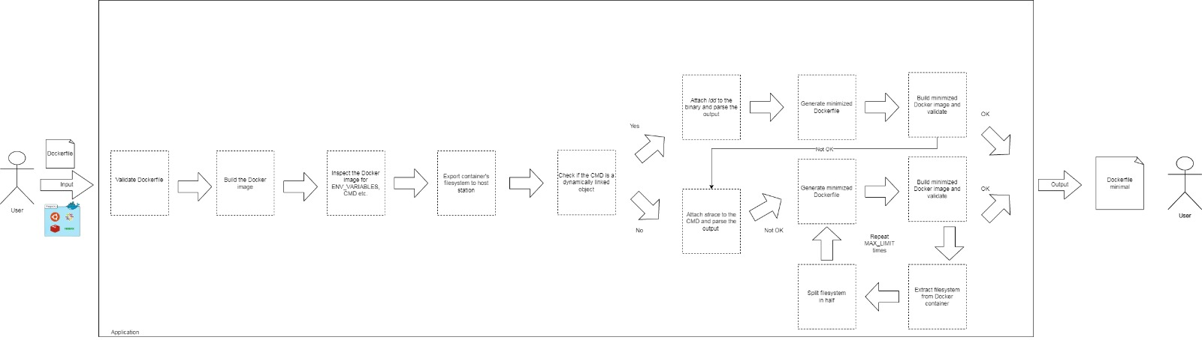
Architecture
High-level architecture of the application

Slide 12
Status and Future Work
ROADMAP
December - February
March
April
May
June
Manually created minimal Dockerfiles for hello-world app in different programming languages and complex one like DBs, Wordpress, headless browsers
Sketched the architectural diagram of the app and checked if the idea is feasible
Start work implementing the solution
Finish the development
Focus on writing the documentation
and presentation

Slide 13
THANK YOU
FOR YOUR ATTENTION!
😊

